Slide 1


Unit-01 Introduction to JAVA
Object Oriented Programming (OOP)
(2101CS203)
Prof. Arjun V. Bala
Computer Engineering Department
arjun.bala@darshan.ac.in
9624822202

Slide 2

Outline
Introduction to JAVA
Features of JAVA
JDK
JRE
JVM
Installing and configuring JAVA
Basic structure of Java program
Compiling Java program
Running Java program
Identifiers
Data types
Type casting
Operators
If statement
Two way if statement
Nested if statement
Switch statement
Conditional Expression
While loop
Do-while loop
For loop
Nested loop
Break and continue statement
Array
Looping

Slide 3



Slide 4
JAVA
Java is a general-purpose computer-programming language that is open source, platform independent, object-oriented and specifically designed to have as few implementation dependencies as possible.
Java was originally developed by James Gosling at Sun Microsystems and released in 1995.
Java was initially named as Oak language and renamed to JAVA in 1995.
Current Version | Java SE 19 (as of jan-2023)
Version we will use | Java SE 17 (LTS)
Setup size | 155 MB (Linux), 152 MB (Windows x64)
Download Link | https://www.oracle.com/java/technologies/downloads/
Official Website | https://java.com
Integrated Development Environment (IDE) | Eclipse (going to use this IDE in later chapters) NetBeans IntelliJ IDEA Community Edition BlueJ

Slide 5
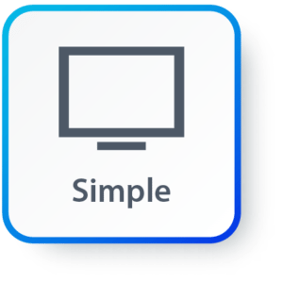
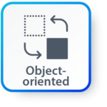
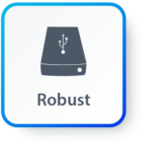

Features of JAVA
Simple: Java inherits C/C++ syntax and many object-oriented features of C++.
Object Oriented: “Everything is an object” paradigm, which possess some state, behavior and all the operations are performed using these objects.
Robust: Java has a strong memory management system. It helps in eliminating error as it checks the code during compile and runtime.
Multithreaded: Java supports multiple threads of execution, including a set of synchronization primitives. This makes programming with threads much easier.

Slide 6



Features of JAVA (Cont.)
Architectural Neutral: Java is platform independent which means that any application written on one platform can be easily ported to another platform.
Interpreted: Java is compiled to bytecodes, which are interpreted by a Java run-time environment.
High Performance: Java achieves high performance through the use of bytecode which can be easily translated into native machine code. With the use of JIT (Just-In-Time) compilers, Java enables high performance.

Slide 7

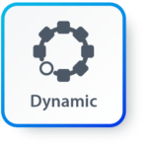
Features of JAVA (Cont.)
Distributed: Java provides a feature which helps to create distributed applications. Using Remote Method Invocation (RMI), a program can invoke a method of another program across a network and get the output. You can access files by calling the methods from any machine on the internet.
Dynamic: Java has ability to adapt to an evolving environment which supports dynamic memory allocation due to which memory wastage is reduced and performance of the application is increased.

Slide 8
Components of Java
Java Virtual Machine (JVM)
Java Runtime Environment (JRE)
Java Development Kit (JDK)
JDK
Compiler (javac.exe)
Java Application
Launcher (java.exe), AppletViewer, etc..)
Java Packages
(math, util, awt etc…)
JVM
Runtime Libraries
Development tools
JRE

Slide 9
Java Development Kit (JDK)
JDK contains tools needed ,
To develop the Java programs and
JRE to run the programs.
The tools include
compiler (javac.exe),
Java application launcher (java.exe),
Appletviewer, etc…
Java application launcher (java.exe) opens a JRE, loads the class, and invokes its main method.

Slide 10
Java Runtime Environment (JRE)
The JRE is required to run java applications.
It combines the Java Virtual Machine (JVM), platform core classes and supporting libraries.
JRE is part of the Java Development Kit (JDK), but can be downloaded separately.
It does not contain any development tools such as compiler, debugger, etc.

Slide 11
Java Virtual Machine (JVM)
JVM is a virtual machine that enables a computer to run Java programs as well as programs written in other languages and compiled to Java Bytecode.
Bytecode is a highly optimized set of instructions designed to be executed by the Java Virtual Machine(JVM).
Byte code is intermediate representation of java source code.
Java compiler provides byte code by compiling Java Source Code.
Extension for java class file or byte code is ‘.class’, which is platform independent.
JVM is virtual because , It provides a machine interface that does not depend on the operating system and machine hardware architecture.
JVM interprets the byte code into the machine code.
JVM itself is platform dependent, but Java is Not.

Slide 12
How Java become Platform Independent?
Source code (Program)
.java file
Compiler
Bytecode
.class file
JVM
(Windows)
JVM
(Linux)
JVM
(Mac)
Machine Code
Machine Code
Machine Code

Slide 13
Installing JDK
Download JDK for Windows platform (.exe) from
https://www.oracle.com/technetwork/java/javase/downloads/index.html
Install the executable of JDK
Set the path variable of System variables by performing following steps
Go to "System Properties" (Right click This PC → Properties → Advanced System Settings)
Click on the "Environment variables" button under the "Advanced" tab
Then, select the "Path" variable in System variables and click on the "Edit" button
Click on the "New" button and add the path where Java is installed, followed by \bin. By default, Java is installed in C:\Program Files\Java\jdk-11.0.1 (If nothing else was specified when you installed it). In that case, You will have to add a new path with: C:\Program Files\Java\jdk-11.0.1\bin
Then, click "OK", and save the settings
At last, open Command Prompt (cmd.exe) and type java -version to see if Java is running on your machine

Slide 14
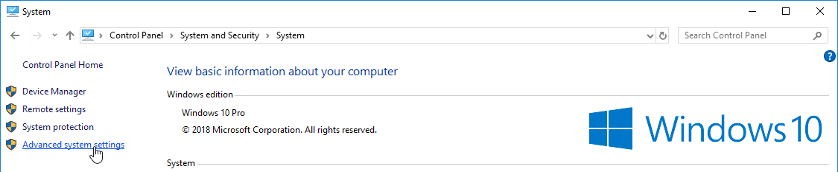
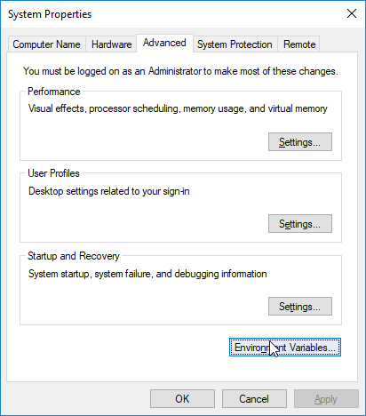
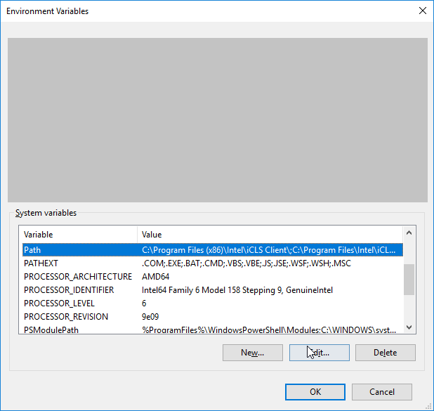
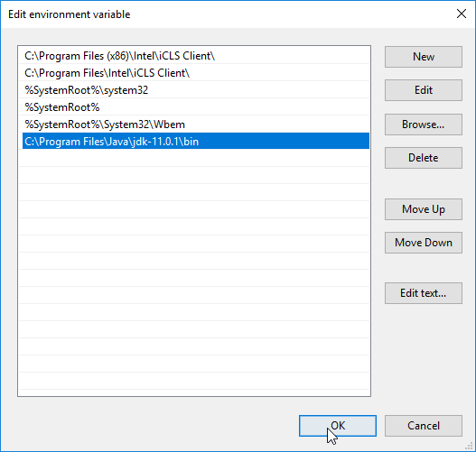
Setting Path Variable
1
2
3
4

Slide 15
Hello World Java Program
File must be saved as HelloWorld.java
public class HelloWorld
{
public static void main(String[] args)
{
System.out.println("Hello World");
}
}
We have to save this in HelloWorld.java file as it has public class named HelloWorld.
String and System are inbuilt Java Classes.
Classes in java are always written in Camel case.
Main method from where execution will start
String must start with capital letter
System must start with capital letter

Slide 16
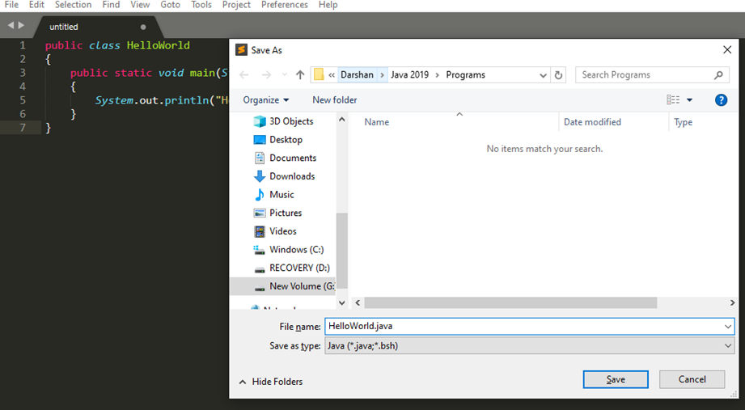
How to execute Java Program?
Save the program with the same name as the public class with .java extension.

Slide 17
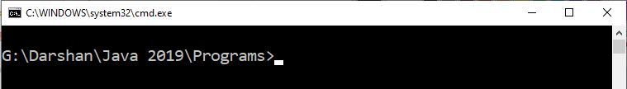
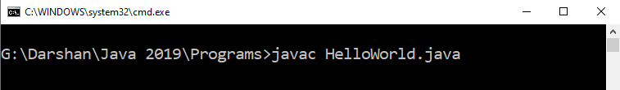
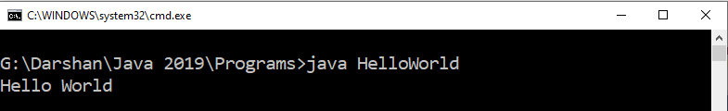
How to execute Java Program?
Open command prompt (cmd) / terminal & navigate to desired directory / folder.
Compile the “.java” file with javac command.
Execute the “.class” file with java command without extension.

Slide 18
Identifiers
Identifiers are used for class names, method names, variable names and more.
An identifier may be any descriptive sequence of
uppercase(A…Z) and lowercase(a..z) letters
Numbers(0..9)
Underscore(_) and dollar-sign($) characters
Rules for Identifiers (other than above mention point)
There should not be any space in an identifier. For example, darshan uni is an invalid identifier.
An identifier should not contain a number at the starting. For example, 123darshan is an invalid identifier.
We can't use the Java reserved keywords as an identifier such as int, float, double, char, etc. For example, int double is an invalid identifier in Java.
Examples for valid Identifiers,
AvgTemp
count
a4
$test
this_is_ok
Examples for invalid Identifiers,
2count
High-temp
Ok/NotOK
(Identifiers can not start with digit)
(Identifiers can not contain dash)
(Identifiers can not contains slash)

Slide 19
Data Types
Java Datatypes
Primitive
Non-primitive
Integers
Floating-point numbers
Characters
Boolean
Class

Slide 20
Primitive Data Types
Data Type | Size | Range | Example
byte | 1 Byte | -128 to 127 | byte a = 10;
short | 2 Bytes | -32,768 to 32,767 | short a = 200;
int | 4 Bytes | -2,147,483,648 to 2,147,483,647 | int a = 50000;
long | 8 Bytes | -9,223,372,036,854,775,808 to 9,223,372,036,854,775,807 | long a = 20;
float | 4 Bytes | 1.4e-045 to 3.4e+038 | float a = 10.2f;
double | 8 Bytes | 4.9e-324 to 1.8e+308 | double a = 10.2;
char | 2 Bytes | 0 to 65536 (Stores ASCII of character) | char a = ‘a’;
boolean | Not defined | true or false | boolean a = true;

Slide 21
Escape Sequences
Escape sequences in general are used to signal an alternative interpretation of a series of characters.
For example, if you want to put quotes within quotes you must use the escape sequence, \", on the interior quotes.
System.out.println("Good Morning \"World\"");
Escape Sequence | Description
\’ | Single quote
\” | Double quote
\\ | Backslash
\r | Carriage return
\n | New Line
\t | Tab

Slide 22
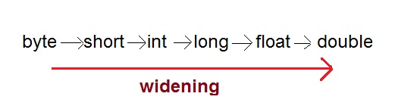
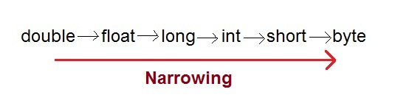
Type Casting
Assigning a value of one type to a variable of another type is known as Type Casting.
In Java, type casting is classified into two types,
Widening/Automatic Type Casting (Implicit)
Narrowing Type Casting(Explicitly done)

Slide 23
Automatic Type Casting
When one type of data is assigned to other type of variable , an automatic type conversion will take place if the following two conditions are satisfied:
The two types are compatible
The destination type is larger than the source type
Such type of casting is called “widening conversion”.
Example:
int can always hold values of byte and short
public static void main(String[] args) {
byte b = 5;
// √ this is correct
int a = b;
}

Slide 24
Casting Incompatible Types
To create a conversion between two incompatible types, you must use a cast
A cast is an explicit type conversion.
Such type is called “narrowing conversion”.
Syntax:
(target-type) value
Example:
public static void main(String[] args) {
int a = 5;
// × this is not correct
byte b = a;
// √ this is correct
byte b = (byte)a ;
}

Slide 25
Operators
Arithmetic Operators
Relational Operators
Bitwise Operators
Logical Operators
Assignment Operators
Conditional / Ternary Operator
Instance of Operator

Slide 26
Arithmetic Operator
Note : A = 10 & B = 20
Operator | Description | Example
+ | Addition | A + B = 30
- | Subtraction | A - B = -10
* | Multiplication | A * B = 200
/ | Division | B / A = 2
% | Modulus | B % A = 0
++ | Increment | B++ = 21
-- | Decrement | B-- = 19

Slide 27
Relational Operators
Note : A = 10 & B = 20
Operator | Description | Example
== | Equals | (A == B) is not true.
!= | Not Equals | (A != B) is true.
> | Greater than | (A > B) is not true.
< | Less than | (A < B) is true.
>= | Greater than equals | (A >= B) is not true.
<= | Less than equals | (A <= B) is true.

Slide 28
Bitwise Operators
Note : A = 60 & B = 13
Operator | Description | Example
& | Binary AND Operator | A & B = 12 which is 0000 1100
| | Binary OR Operator | A | B = 61 which is 0011 1101
^ | Binary XOR Operator | A ^ B = 49 which is 0011 0001
~ | Binary Ones Complement Operator | ~A = -61 which is 1100 0011 in 2's complement form due to a signed binary number.
<< | Binary Left Shift Operator | A << 2 = 240 which is 1111 0000
>> | Binary Right Shift Operator. | A >> 2 = 15 which is 1111
>>> | Shift right zero fill operator. | A >>>2 = 15 which is 0000 1111

Slide 29
Logical Operators
Note : A = true & B = false
Operator | Description | Example
&& | Logical AND operator | (A && B) is false.
|| | Called Logical OR Operator | (A || B) is true.
! | Called Logical NOT Operator | !(A && B) is true.

Slide 30
Assignment Operators
Operator | Description | Example
= | Simple assignment operator | C = A + B will assign value of A + B into C
+= | Add AND assignment operator | C += A is equivalent to C = C + A
-= | Subtract AND assignment operator | C -= A is equivalent to C = C - A
*= | Multiply AND assignment operator | C *= A is equivalent to C = C * A
/= | Divide AND assignment operator | C /= A is equivalent to C = C / A
%= | Modulus AND assignment operator | C %= A is equivalent to C = C % A
<<= | Left shift AND assignment operator | C <<= 2 is same as C = C << 2
>>= | Right shift AND assignment operator | C >>= 2 is same as C = C >> 2
&= | Bitwise AND assignment operator | C &= 2 is same as C = C & 2
^= | bitwise exclusive OR and assignment operator | C ^= 2 is same as C = C ^ 2
|= | bitwise inclusive OR and assignment operator | C |= 2 is same as C = C | 2

Slide 31
Conditional Operator (Ternary)
Conditional Operator ( ? : )
Syntax:
variable x = (expression) ? value if true : value if false
Example:
b = (a == 1) ? 20 : 30;

Slide 32
Operator Precedence & Associativity
How does java evaluate 1 + 10 * 9 ?
(1 + 10 ) * 9 = 99 OR 1 + (10 * 9) = 91
To get the correct answer for the given problem Java came up with Operator precedence. ( multiplication have higher precedence than addition so correct answer will be 91 in this case)
For Operator, associativity means that when the same operator appears in a row, then to which direction the expression will be evaluated.
How does java evaluate 1 * 2 + 3 * 4 / 5 ???
2 + 12 / 5
2 + 2.4
4.4

Slide 33
Precedence of Java Operators
Category | Operator | Associativity
Postfix | () [] . (dot operator) | Left to right
Unary | ++ - - ! ~ | Right to left
Multiplicative | * / % | Left to right
Additive | + - | Left to right
Shift | >> >>> << | Left to right
Relational | > >= < <= | Left to right
Equality | == != | Left to right
Bitwise AND | & | Left to right
Bitwise XOR | ^ | Left to right
Bitwise OR | | | Left to right
Logical AND | && | Left to right
Logical OR | || | Left to right
Conditional | ?: | Right to left
Assignment | = += -= *= /= %= >>= <<= &= ^= |= | Right to left
Comma | , | Left to right

Slide 34
Control Statements
Control Statements in Java is one of the fundamentals required for Java Programming. It allows the smooth flow of a program.
Statement can simply be defined as an instruction given to the computer to perform specific operations.
A control statement in java is a statement that determines whether the other statements will be executed or not.
Control statements in Java,
If statement
If-else statement
If-else ladder statement
Switch statement

Slide 35
if statement
if statement tests the condition. It executes the if block if condition is true.
public class IfStatementDemo{
public static void main(String[] ar)
{
int a = 10, b = 20;
if( a < b ) {
System.out.println("A is smaller than B");
}
}
}

Slide 36
if-else statement
if-else statement also tests the condition. It executes the if block if condition is true otherwise else block is executed.
public class IfElseStatementDemo{
public static void main(String[] ar)
{
int a = 10, b = 20;
if(a<b) {
System.out.println("A is smaller than B");
}
else {
System.out.println(“A is not smaller than B");
}
}
}

Slide 37
if-else statement
if-else-if ladder statement executes one condition from multiple statements.
int marks = 65;
if (marks < 60) {
System.out.println("fail");
} else if (marks >= 60 && marks < 80) {
System.out.println("B grade");
} else if (marks >= 80 && marks < 90) {
System.out.println("A grade");
} else if (marks >= 90 && marks < 100) {
System.out.println("A+ grade");
} else {
System.out.println("Invalid!");
}

Slide 38
Nested If statement
We can also use if/else if statement inside another if/else if statement, this is known as nested if statement.
int username = Integer.parseInt(args[0]);
int password = Integer.parseInt(args[1]);
double balance = 123456.25;
if(username==1234){
if(password==987654){
System.out.println("Your Balance is ="+balance);
}
else{
System.out.println("Password is invalid");
}
}
else{
System.out.println("Username is invalid");
}

Slide 39
switch statement
switch statement executes one statement from multiple conditions. It is like if-else-if ladder statement.
public class SwitchExampleDemo {
public static void main(String[] args)
{
int number = 20;
switch (number) {
case 10:
System.out.println("10");
break;
case 20:
System.out.println("20");
break;
default:
System.out.println("Not 10 or 20");
}
}
}

Slide 40
Programs to perform (Conditional Statements)
Write a Java program to get a number from the user and print whether it is positive or negative.
Write a program to find maximum no from given 3 no.
The marks obtained by a student in 5 different subjects are input through the keyboard.
The student gets a division as per the following rules:
Percentage above or equals to 60-first division
Percentage between 50 to 59-second division
Percentage between 40 and 49-Third division
Percentage less than 40-fail
Write a program to calculate the division obtained by the student.
Write a Java program that takes a number from the user and displays the name of the weekday accordingly (For example if user enter 1 program should return Monday) .

Slide 41
Looping Statement
Looping in programming languages is a feature which facilitates the execution of a set of instructions/functions repeatedly while some condition evaluates to true.
Java provides three ways for executing the loops. While all the ways provide similar basic functionality, they differ in their syntax and condition checking time.
While loop
Do-while loop
For
Foreach (will cover this after array)

Slide 42
While Loop
while loop is used to iterate a part of the program several times. while is entry control loop.
If the number of iteration is not fixed, it is recommended to use while loop.
//code will print 1 to 9
public class WhileLoopDemo {
public static void main(String[] args) {
int number = 1;
while(number < 10) {
System.out.println(number);
number++;
}
}
}

Slide 43
Do-while Loop
do-while loop is executed at least once because condition is checked after loop body.
//code will print 1 to 9
public class DoWhileLoopDemo {
public static void main(String[] args) {
int number = 1;
do {
System.out.println(number);
number++;
}while(number < 10) ;
}
}

Slide 44
For Loop
for loop is used to iterate a part of the program several times.
If the number of iteration is fixed, it is recommended to use for loop.
//code will print 1 to 9
public class ForLoopDemo {
public static void main(String[] args)
{
for(int number=1;number<10;number++)
{
System.out.println(number);
}
}
}

Slide 45
Nested Loop

Slide 46
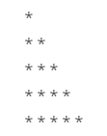
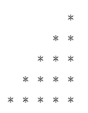





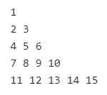


Programs to perform (Looping Statements)
Write a program to print first n odd numbers.
Write a program to check that the given number is prime or not.
Write a program to draw given patterns,

Slide 47
Break statement
When a break statement is encountered inside a loop, the loop is immediately terminated and the program control resumes at the next statement following the loop.
//code will print 1 to 4 followed by “After Loop”
public class BreakDemo{
public static void main(String[] args)
{
for(int number=1;number<10;number++)
{
if(number==5) {
break;
}
System.out.println(number);
}
System.out.println(“After Loop”);
}
}

Slide 48
Continue statement
The continue statement is used in loop control structure when you need to immediately jump to the next iteration of the loop. It can be used with for loop or while loop.
//code will print 1 to 9 but not 5, followed by “After Loop”
public class ContinueDemo {
public static void main(String[] args)
{
for(int number=1;number<10;number++)
{
if(number==5) {
continue;
}
System.out.println(number);
}
System.out.println(“After Loop”);
}
}

Slide 49
Array
An array is a collection of similar type of elements that have contiguous memory location and shares a common name.
Syntax : data_type variable_name[] = new type[size_of_array];
Example : int a[] = new int[10];
The data_type specifies the type of the elements that can be stored in an array, like int, float, char etc...
The size_of_array indicates the maximum number of elements that can be stores inside the array.
In the example, data type of an array is int and maximum elements that can be stored in an array are 10.
Important point about Java array.
An array is derived datatype.
An array is dynamically allocated.
The individual elements of an array is refereed by their index/subscript value.
The subscript for an array always begins with 0.
35
13
28
106
a
35
42
5
83
97
14
a[0]
a[1]
a[2]
a[3]
a[4]
a[5]
a[6]
a[7]
a[8]
a[9]

Slide 50
One-Dimensional Array
An array using one subscript to represent the list of elements is called one dimensional array.
A One-dimensional array is essentially a list of like-typed variables.
Array declaration: type var-name[];
Example: int student_marks[];
Above example will represent array with no value (null).
To link student_marks with actual array of integers, we must allocate one using new keyword.
Example: int student_marks[] = new int[20];

Slide 51
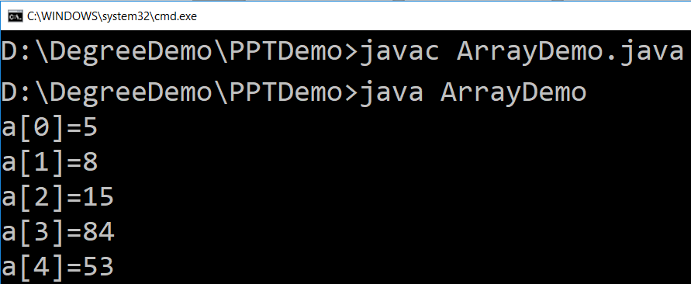
Example (Array)
public class ArrayDemo{
public static void main(String[] args) {
int a[]; // or int[] a
// till now it is null as it does not assigned any memory
a = new int[5]; // here we actually create an array
a[0] = 5;
a[1] = 8;
a[2] = 15;
a[3] = 84;
a[4] = 53;
/* in java we use length property to determine the length
* of an array, unlike c where we used sizeof function */
for (int i = 0; i < a.length; i++) {
System.out.println("a["+i+"]="+a[i]);
}
}
}

Slide 52
Multi-Dimensional Array
In java, multidimensional array is actually array of arrays.
Example: int runPerOver[][] = new int[3][6];
length field:
If we use length field with multidimensional array, it will return length of first dimension.
Here, if runPerOver.length is accessed it will return 3
Also if runPerOver[0].length is accessed it will be 6
First Over (a[0])
4
0
1
3
6
1
a[0][0]
a[0][1]
a[0][2]
a[0][3]
a[0][4]
a[0][5]
1
1
0
6
0
4
Second Over (a[1])
a[1][0]
a[1][1]
a[1][2]
a[1][3]
a[1][4]
a[1][5]
2
1
1
0
1
1
Third Over (a[2])
a[2][0]
a[2][1]
a[2][2]
a[2][3]
a[2][4]
a[2][5]

Slide 53
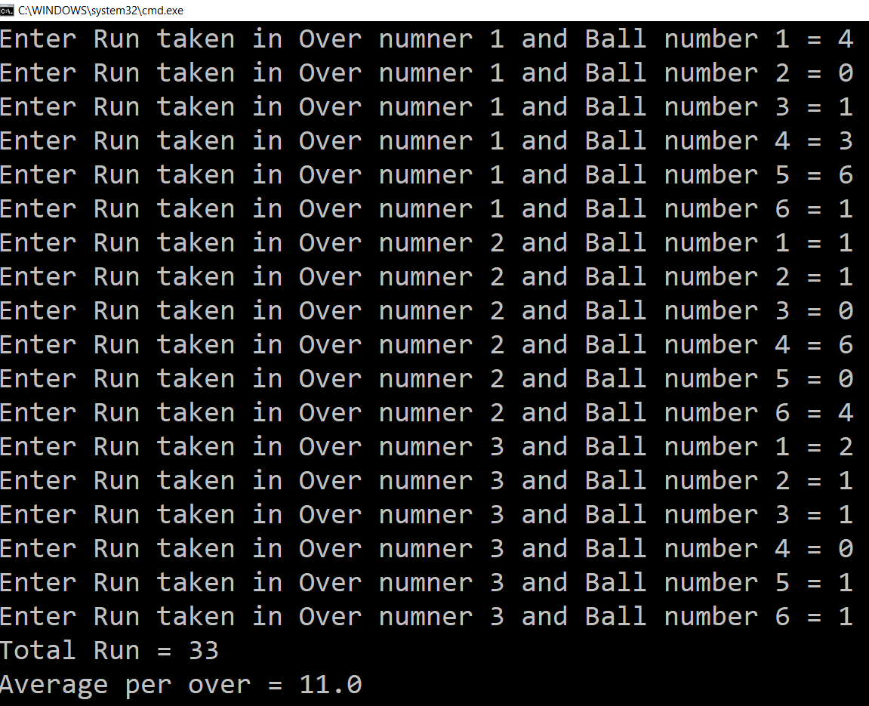
Multi-Dimensional Array (Example)
Scanner s = new Scanner(System.in);
int runPerOver[][] = new int[3][6];
for (int i = 0; i < 3; i++) {
for (int j = 0; j < 6; j++) {
System.out.print("Enter Run taken" +
" in Over numner " + (i + 1) +
" and Ball number " + (j + 1) + " = ");
runPerOver[i][j] = s.nextInt();
}
}
int totalRun = 0;
for (int i = 0; i < 3; i++) {
for (int j = 0; j < 6; j++) {
totalRun += runPerOver[i][j];
}
}
double average = totalRun / (double) runPerOver.length;
System.out.println("Total Run = " + totalRun);
System.out.println("Average per over = " + average);

Slide 54
Multi-Dimensional Array (Cont.)
manually allocate different size:
int runPerOver[][] = new int[3][];
runPerOver[0] = new int[6];
runPerOver[1] = new int[7];
runPerOver[2] = new int[6];
initialization:
int runPerOver[][] = {
{0,4,2,1,0,6},
{1,-1,4,1,2,4,0},
{6,4,1,0,2,2},
}
Note : here to specify extra runs (Wide, No Ball etc.. ) negative values are used

Slide 55
Searching in Array
Searching is the process of looking for a specific element in an array. for example, discovering whether a certain element is included in the array.
Searching is a common task in computer programming. Many algorithms and data structures are devoted to searching.
We will discuss two commonly used approaches,
Linear Search: The linear search approach compares the key element key sequentially with each element in the array. It continues to do so until the key matches an element in the array or the array is exhausted without a match being found.
Binary Search: The binary search first compares the key with the element in the middle of the array. Consider the following three cases:
If the key is less than the middle element, you need to continue to search for the key only in the first half of the array.
If the key is equal to the middle element, the search ends with a match.
If the key is greater than the middle element, you need to continue to search for the key only in the second half of the array.
Note: Array should be sorted in ascending order if we want to use Binary Search.

Slide 56
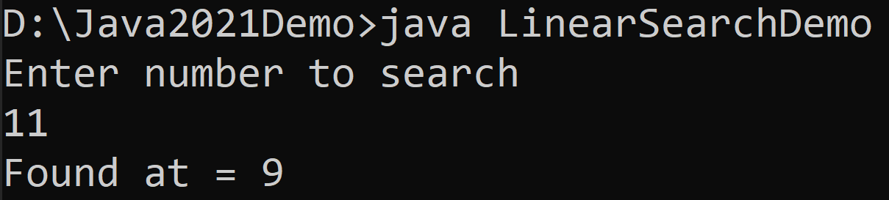
Linear Search
import java.util.Scanner;
public class LinearSearchDemo{
public static void main(String[] args){
int[] myArray = {5,3,6,8,4,6,2,8,9,11};
Scanner sc = new Scanner(System.in);
System.out.println("Enter number to search");
int searchNumber = sc.nextInt();
sc.close();
boolean flag = false;
for(int i=0;i<myArray.length;i++){
if(myArray[i]==searchNumber){
System.out.println("Found at = "+i);
flag = true;
break;
}
}
if(!flag){
System.out.println("Number does not exist in array");
}
}
}

Slide 57
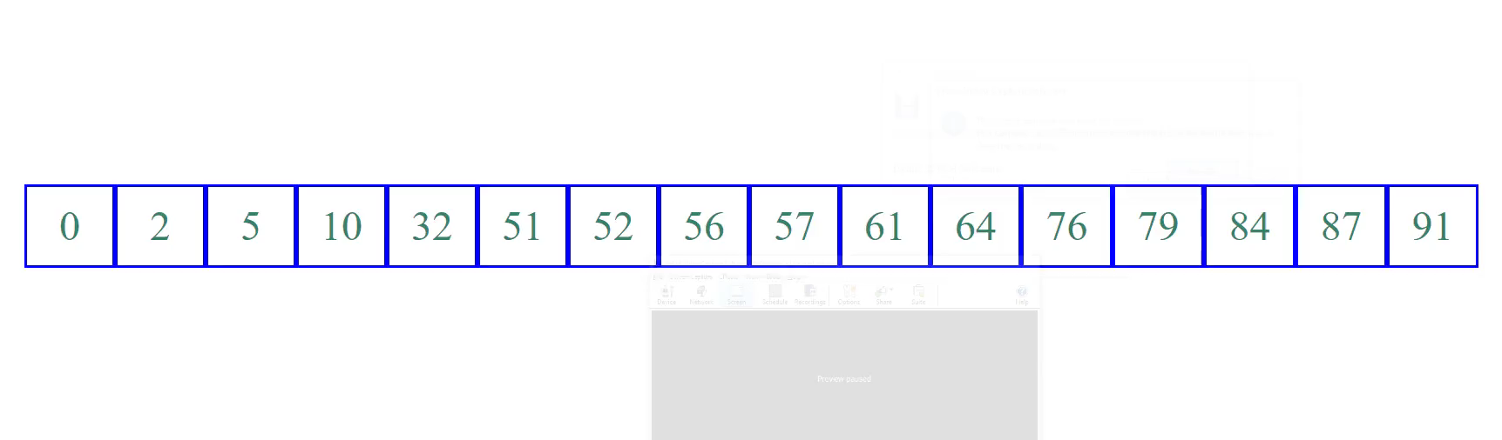
Binary Search (Animation)

Slide 58
Binary Search
import java.util.Scanner;
public class BinarySearchDemo {
public static void main(String[] args) {
int[] myArray
= {2,3,5,6,8,9,11,18,29,65};
Scanner sc = new Scanner(System.in);
System.out.println
("Enter number to search");
int searchNumber = sc.nextInt();
sc.close();
int low = 0;
int high = myArray.length - 1;
boolean isFound = false;
while(high>=low) {
int mid = (high + low) / 2 ;
if(searchNumber < myArray[mid]) {
high = mid - 1;
}
else if(searchNumber == myArray[mid]) {
System.out.println("Found at = "+mid);
isFound = true;
break;
}
else {
low = mid + 1;
}
}
if(!isFound) {
System.out.println
("Number does not exist in array");
}
}
}

Slide 59
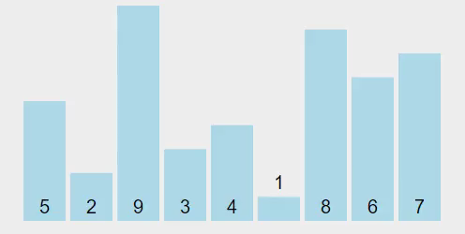
Sorting Array
Sorting, like searching, is a common task in computer programming. Many different algorithms have been developed for sorting.
There are many sorting techniques available, we are going to explore selection sort.
Selection sort
finds the smallest number in the list and swaps it with the first element.
It then finds the smallest number remaining and swaps it with the second element, and so on, until only a single number remains.

Slide 60
Selection Sort (Example)
int a[] = { 5, 2, 9, 3, 4, 1, 8, 6, 7 };
for (int i = 0; i < a.length - 1; i++) {
// Find the minimum in the list[i..a.length-1]
int currentMin = a[i];
int currentMinIndex = i;
for (int j = i + 1; j < a.length; j++) {
if (currentMin > a[j]) {
currentMin = a[j];
currentMinIndex = j;
}
}
// Swap a[i] with a[currentMinIndex] if necessary
if (currentMinIndex != i) {
a[currentMinIndex] = a[i];
a[i] = currentMin;
}
}
for(int temp: a) { // this is foreach loop
System.out.print(temp + ", ");
}

